Slide 1


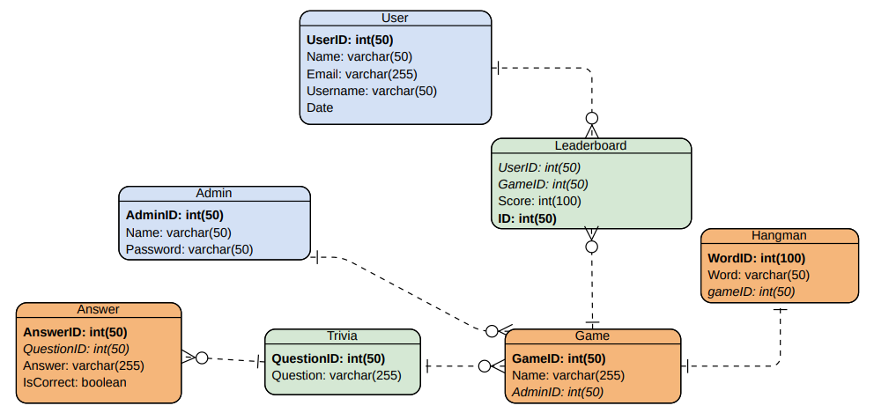
TRIVIA GAMES
Isabel Mattivi, Emma Maykut, Stephanie Motz, Nolan Pettit, Dani Strausburger
Professor Nancy Reddig, Dr. Sara Atwood
PURPOSE
To craft an interactive and user-friendly website, we aim to provide incoming Etown students with an engaging platform. Here, they can discover information about the school through trivia and enjoy playing interactive games such as Flight of the Jay, Flappy Jay, 2048 (Etown Edition), and Professor Pursuit
ER MODEL
In our model, the "User" table maintains user profiles, while the "Trivia" and "Answer" tables manage Etown-related trivia questions and answers. The "Hangman" table holds words for the Hangman game, linked to an overarching "Game" entity. The "Leaderboard" table keeps track of users' scores and Administrators are securely managed in the "Admin" table.
KEY PROBLEMS & DIVISION OF LABOR
Create & link database to the trivia game
Data Management
CRUD Methods
Organizing database
Data encryption
Game Development
Flight of the Jay, Pacman, Flappy Jay, 2048
Updating question and word list for trivia and hangman
Editing the wordlist in the settings page
Adding/removing trivia questions
Ello
KEY FEATURES
User interface to collect basic information for later viewing
Users are prompted to enter a name, username, and email, then are directed to trivia page
Trivia interface quizzes users on Elizabethtown themed questions
Users answer three Etown College related trivia questions, before being directed to game selection
Etown themed games that become available after quiz completion
Users can choose between Etown themed version of classic games, such as Flight of the Jay (Hangman), or Professor Pursuit (Pacman)
Secure administrator abilities to edit user experiences
Administrators can add or delete trivia questions, view user insights and more through a secure connection
IMPACT
We created an in-depth, interactive experience for perspective students.
TESTING PROCESS
Created three use cases which gave step-by-step descriptions of how users will interact with our website. We also created a traceability matrix to ensure complete requirement usage.
Use Cases: Setting/Login, Start Game Feature, and Hangman
These three use cases help give a comprehensive overview of our website and give the user's a demonstration on how the software should react.
REFERENCES & ACKNOWLEDGEMENTS
We recognize and thank everyone who helped us along this process and got us to the point we are now. Thank you to Professor Nancy Reddig, and Dr. Sara Atwood.
We would like to acknowledge the use of open-source code for Pac-Man done by Johan Hasselqvist and Lars Gunther
Software Engineering Project 2023
EDUCATE FOR SERVICE. ENGINEER FOR SOCIETY.
Notes:
Introduction. Include the student name, company name, internship location, internship position, and internship dates. Also note the course rubric and number, course title, and instructor(s). In addition, describe how you secured the internship.
Abstract. The abstract should provide a concise summary of what was done and learned in the internship and the course.
Learning Objectives. List 2 to 5 learning objectives that you had planned to achieve by completing the internship.
Description of Key Responsibilities. Summarize the major responsibilities, activities, and project(s) completed during the internship.
Application of VWU courses to the internship. Explain how your coursework helped with the internship. Link relevant courses, theories, and concepts to their applications within the internship.
Lessons Learned. Explain what you learned about the industry, the company, the career process, and yourself through the internship experience.
Acknowledgements. Recognize the people who helped you, including the internship site supervisor, the course instructor, and mentors. Include full titles in the acknowledgements. In addition, acknowledge funding sources.
Visuals. Incorporate visual aids to illustrate key points. Be sure to label all visuals. Include: names, dates, locations, and photographers. Do not include photographs of children unless you have secured approval from your site supervisor to use the children’s images.

